Slide 1
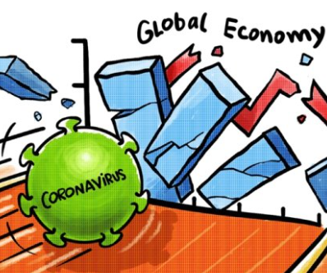
TEAM 4
Yixiao (Sookie) Ji
Ajay Chemuri
Min Shi
Pushkar Nagpal

Slide 2

BACKGROUND
AMERICAS
Argentina, Brazil, Canada, Chile, Mexico, Peru, United States
The Goldman Sachs Group, Inc - advances sustainable economic growth and financial opportunity across the globe.
4 primary segments 85% + 15% + 5%
Investment banking
Global markets
Asset management
Wealth management
3 regions
Americas
EMA
Asia
ASIA PACIFIC
Australia, China, India, Indonesia, Japan, Korea, Malaysia, Singapore, New Zealand
EMA
(Europe, Middle East &Africa)
Belgium, Denmark, France, Germany, Greece, Ireland, Israel, Italy, Luxembourg, Monaco, Netherlands, etc.

Slide 3

SCOPE & STEPS
Pre-covid vs. Post-Covid
Globally vs. Nationally
CPIs & PPIs & International Imports and Exports
Time Series Forecasting
Projections and Recommendations

Slide 4
TIME SERIES
ARIMA:
Univariate model or one with covariates (predictors)
Autoregressive integrated moving average method
A statistical model to predict the future values using historical values.
ETS:
Univariate time series forecasting model
Exponential smoothing method
TS Compare:
lowest error values

Slide 5
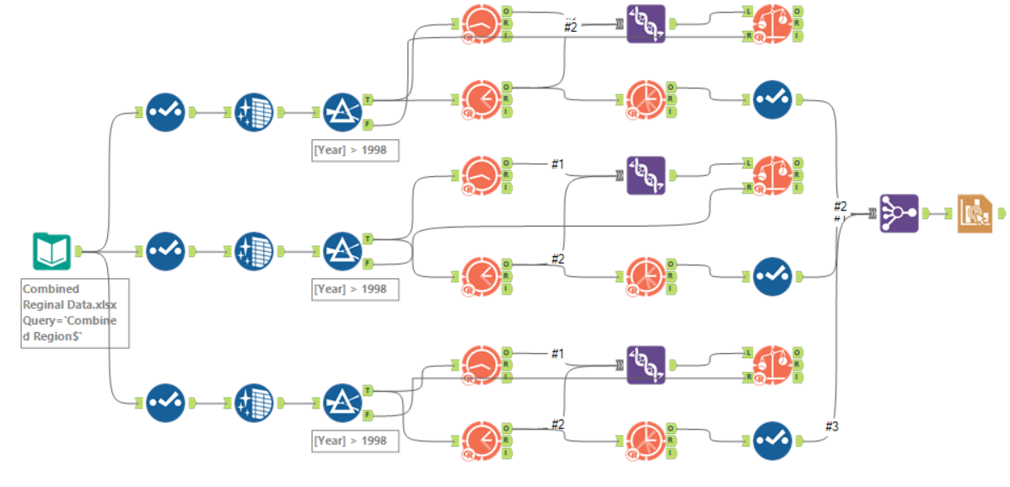
Combine Data
ARIMA
ETS
Compare
TS Forecast
Interactive Chart

Slide 6
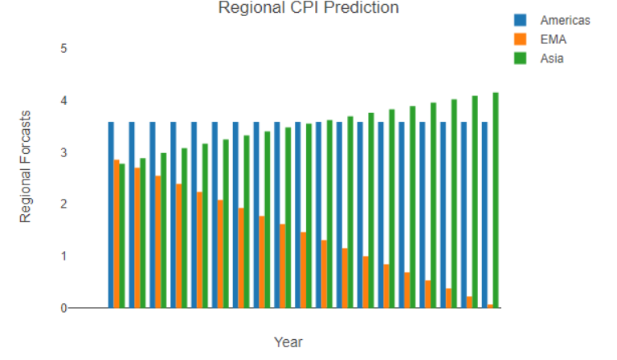
REGIONAL FORECASTING

Slide 7
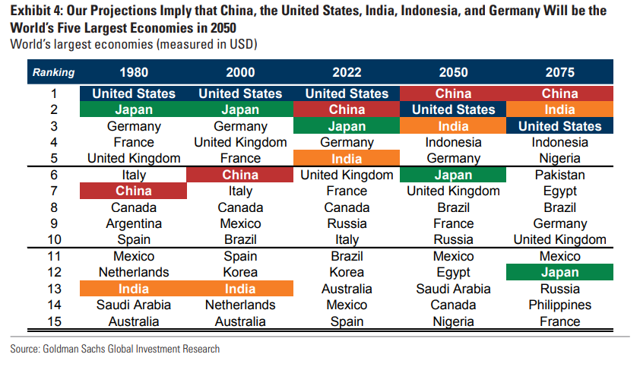
THE PATH TO 2075

Slide 8
WEALTH MANAGEMENT FACTORS
From Product Price Index
Finance
Recreation
Real Estate
Insurance
Motor Vehicles
Recreation
Accommodation
Apparel
Air Transportation
From Consumer Price Index
Recreation
What are we predicting here?

Slide 9
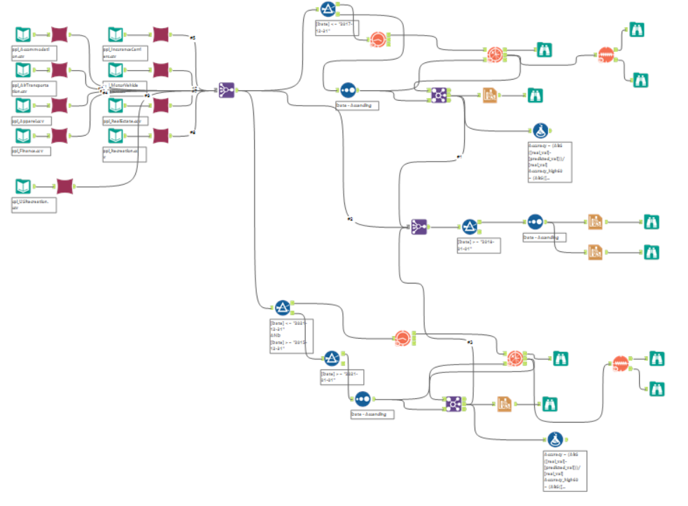
WEALTH MANAGEMENT PPI

Slide 10
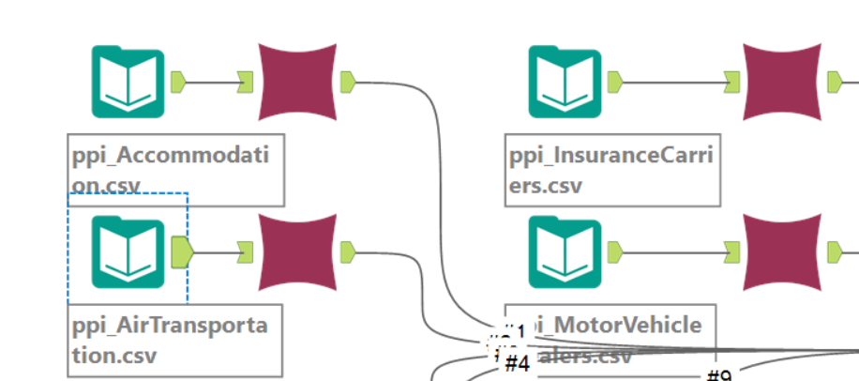
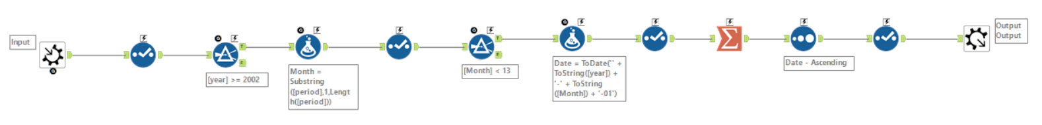
DATA PROCESSING

Slide 11
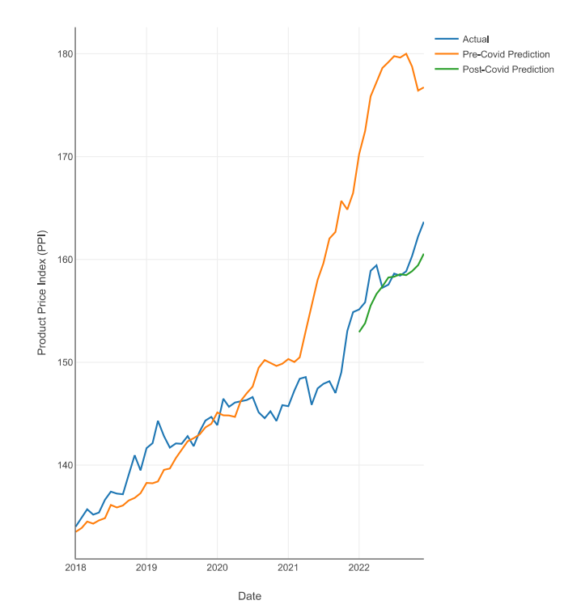
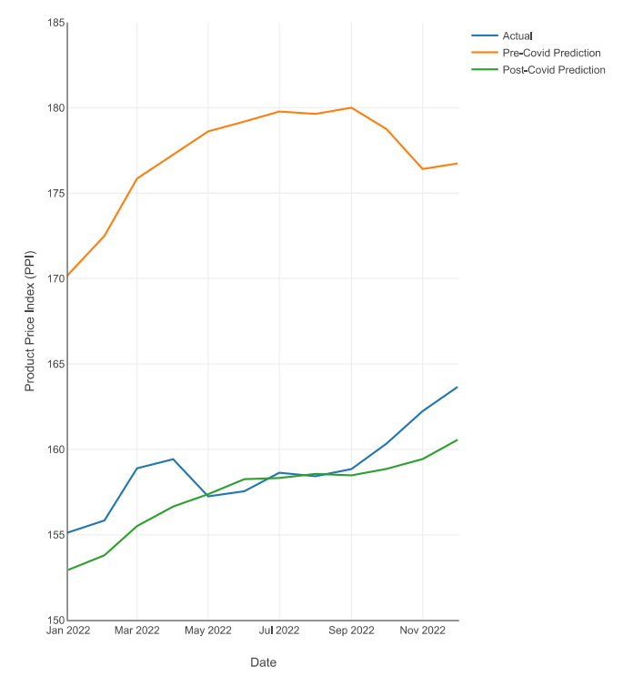
PREDICTION

Slide 12
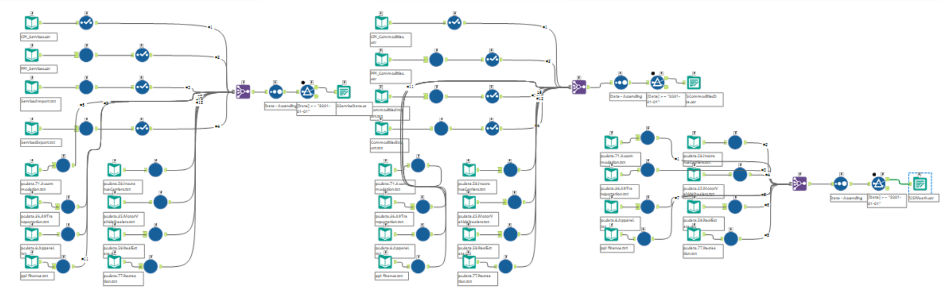
US BUREAU DATA GENERATION

Slide 13
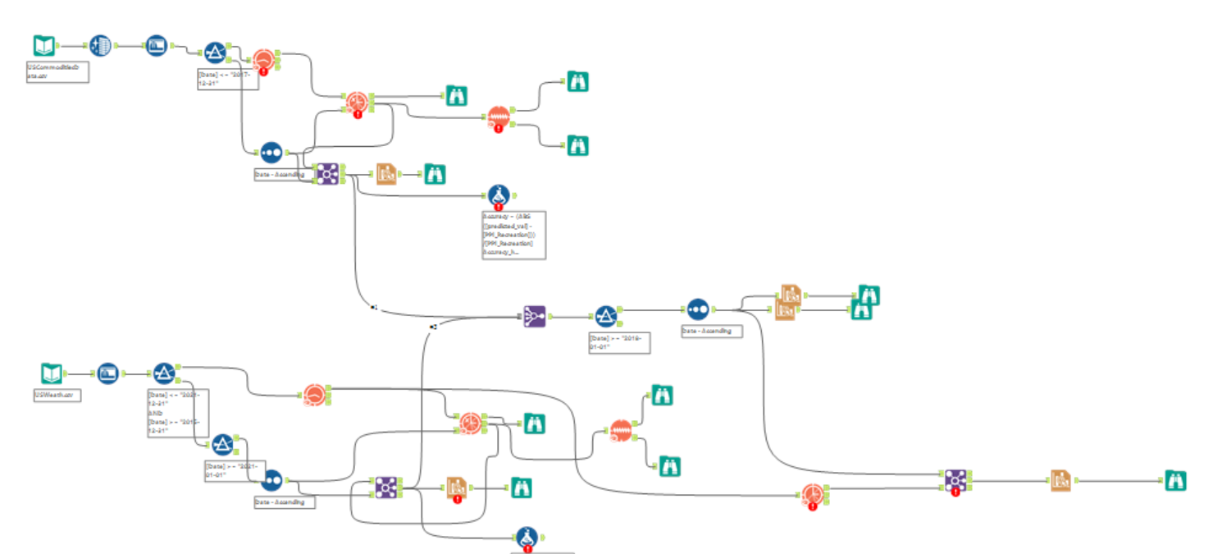
US SERVICES ALTERYX WORKFLOW

Slide 14
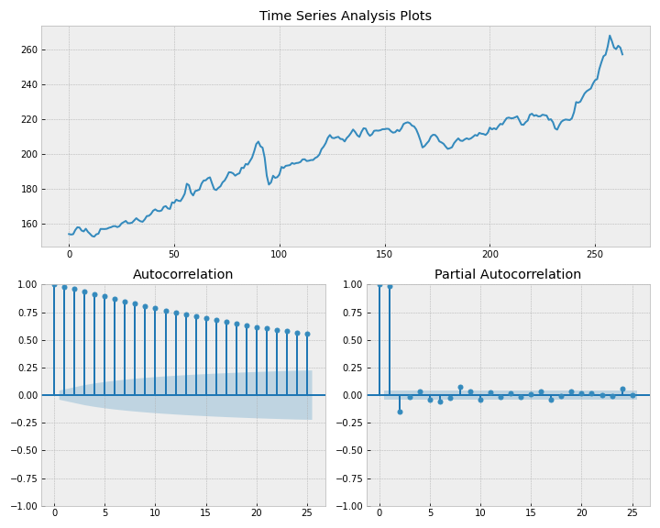
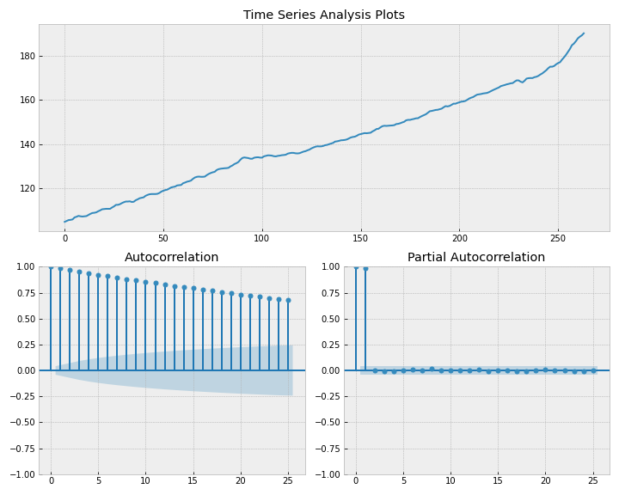
US SERVICES CPI & PPI Overview

Slide 15
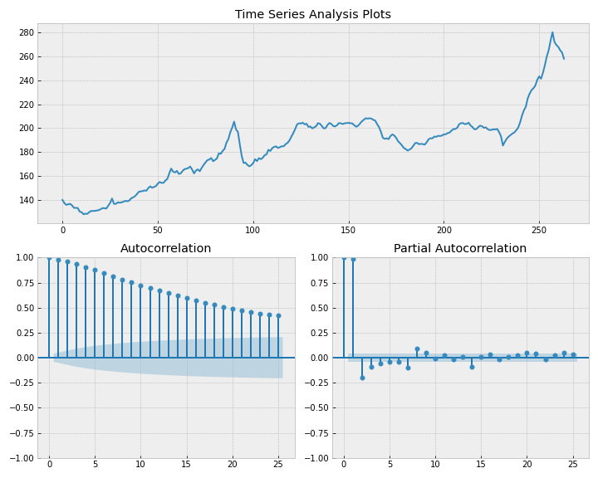
US COMMODITIES PPI OVERVIEW

Slide 16
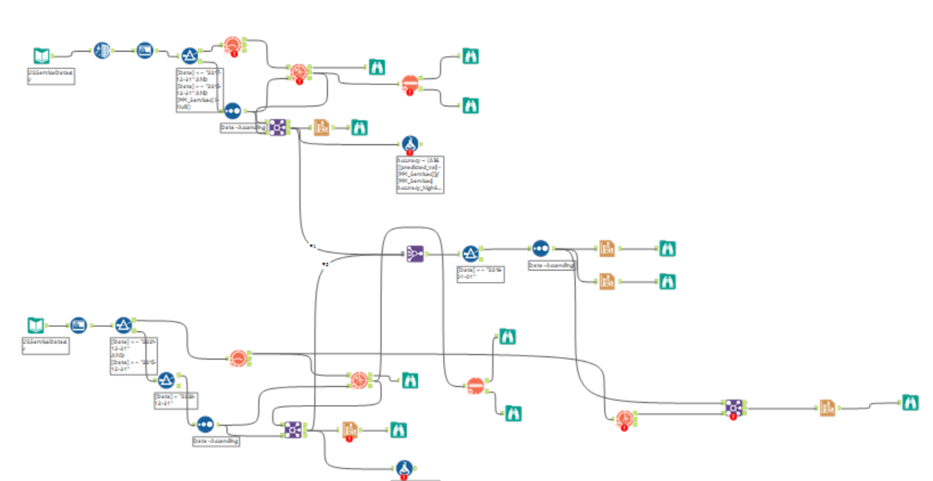
US COMMODITIES ALTERYX WORKFLOW

Slide 17
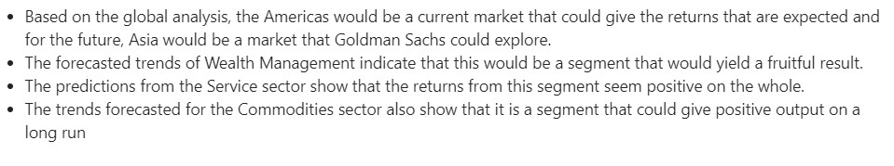
RECOMMENDATION

Slide 18
REFERENCES
https://www.goldmansachs.com/insights/pages/gs-research/the-path-to-2075-slower-global-growth-but-convergence-remains-intact/report.pdf

